Slide 1



Carbon Emissions Prediction
Name: Mohammed Ahmed Khan
AICTE St_ID: STU682efe7143dc61747910257

Slide 2

Learning Objectives
The objective of this project is to develop a machine learning model that predicts CO₂ emissions based on a country’s CO₂ level emissions per capita. The key learning outcomes include:
Understanding use and implementation of different Libraries in python,
Understanding the process of loading , cleaning and preprocessing real-world datasets.
Evaluating machine learning models using appropriate metrics such as R², MSE, and RMSE score.
Applying regression models to predict continuous target values.
Cross Validation and Hyperparameter Tuning.
Carbon Dioxide Emission prediction of different Countries over the years
Where India stands compared to other countries like USA, New Zeland, Russia etc.
GOAL
Source :
www.freepik.com/

Slide 3
Tools and Technology used
VS Code (Visual Studio Code) – Code editor used to run Python code locally.
Python 3.13.3 – Primary language used for coding and data processing.
Data set Acquired from : https://www.data.gov.in.
Libraries like
Pandas – For data loading and manipulation.
NumPy – For numerical operations.
Matplotlib & Seaborn – For data visualization, etc.
Scikit-learn (sklearn) – For building and evaluating the regression models (Linear Regression, Decision Tree Regressor).

Slide 4
Methodology
Data Collection: The dataset containing country-level CO₂ emissions, GDP, urban population, etc was imported from a CSV file.
Data Preprocessing & EDA: Missing values were handled, and outliers were removed.
Model Selection: Linear Regression was used as a baseline model. Random Forest Regressor was chosen for its ability to handle complex, non-linear relationships.
Model Training: Data was split into training and testing sets. Models were trained using scikit-learn, and hyperparameters were tuned using RandomizedSearchCV.
Evaluation: Models were evaluated using R², MSE and RMSE score. It performed best with a test R² of ~0.986 or 98.6%.
Prediction: The final model was used to forecast CO₂ emissions 20,25 years into the future for selected countries using projected feature values.

Slide 5
Problem Statement:
Each year, human activities release more carbon dioxide into the atmosphere than natural processes can remove, causing the amount of carbon dioxide in the atmosphere to increase.
Atmospheric carbon dioxide is now 50 percent higher than it was before the Industrial Revolution.
If global energy demand continues to grow rapidly and we meet it mostly with fossil fuels, human emissions of carbon dioxide could reach 75 billion tons per year or more by the end of the century. Atmospheric carbon dioxide amounts could be 800 ppm or higher -conditions not seen on Earth for close to 50 million years.
The ocean has absorbed enough carbon dioxide to lower its pH by 0.1 units, a 30% increase in acidity.
By adding more carbon dioxide to the atmosphere, people are amplifying the natural greenhouse effect, causing global temperature to rise. According to observations and analysis by the NOAA Global Monitoring Laboratory, carbon dioxide alone is responsible for about 80 percent of the total heating influence of all human-produced greenhouse gases since 1990.

Slide 6
Solution:
To address the issue of growing CO₂ emissions and anticipate their future impact, I built a machine learning model that predicts a country's future CO₂ emissions (2010 - 2030) based on its current per capita CO₂ emission values.
This can help Engineers and Policymakers make informed decisions about sustainable development, carbon budgeting and emission reduction strategies. Accurate forecasting models can guide national energy planning, and prioritize investment in renewable energy sources. By identifying trends and high-risk regions, such models can also support global efforts to mitigate climate change more effectively.
To build this model, I used a machine learning technique called Random Forest Regressor, which works well for finding patterns in complex data. Key features such as energy use per capita, GDP, urban population, and GNI were selected to ensure only the most relevant data was used. The model was trained using past data and tested to make sure it was accurate using R² and RMSE metrics
GitLink: https://github.com/Mak2k25/M-Ahmed.Khan.git

Slide 7
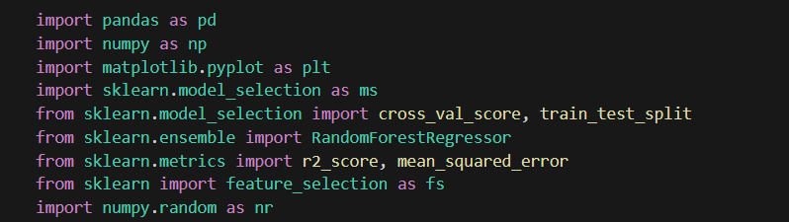
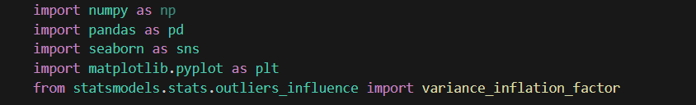
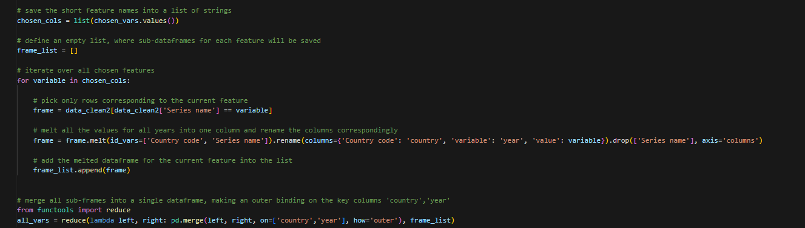
Screenshot of Output:
Libraries used:
Data Cleaning:

Slide 8
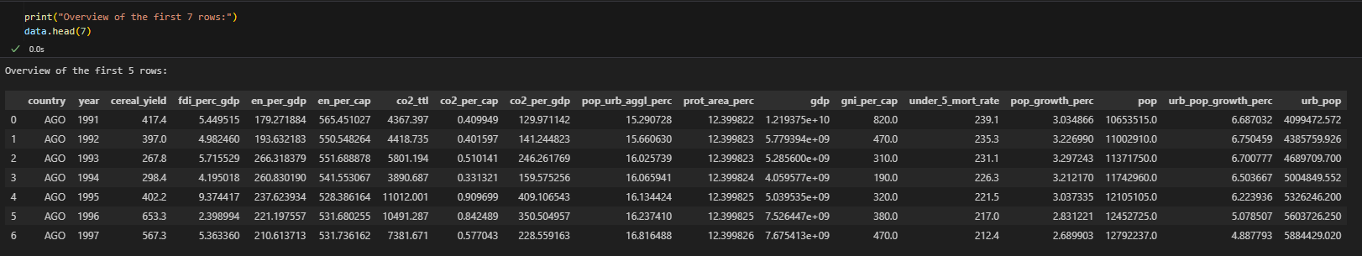
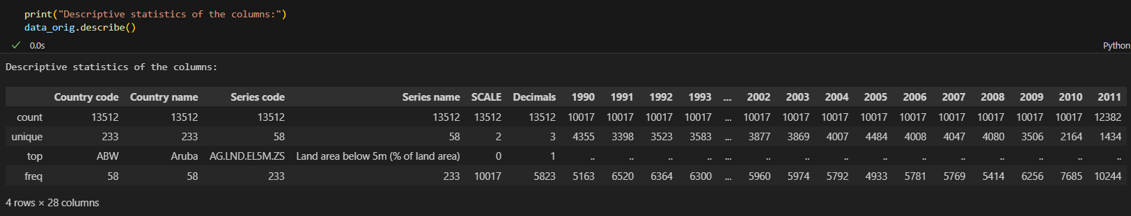
Cleaned
Data
EDA:

Slide 9
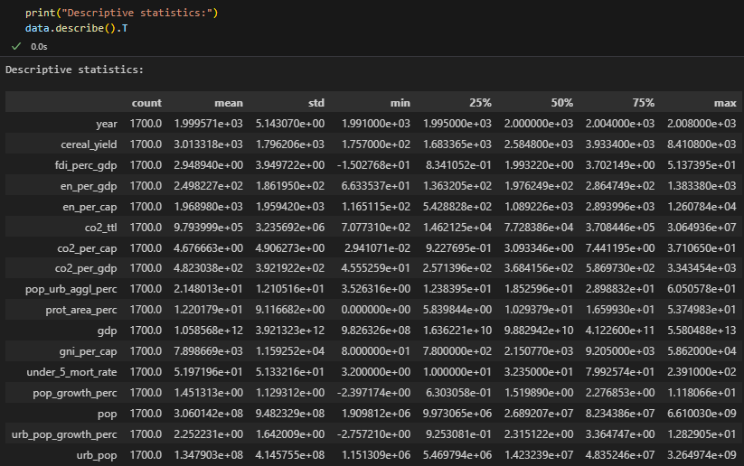
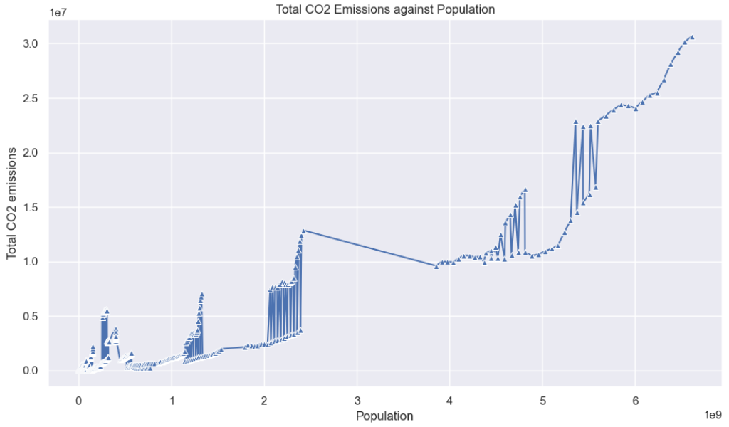
Line plot: Population vs CO₂ emissions

Slide 10
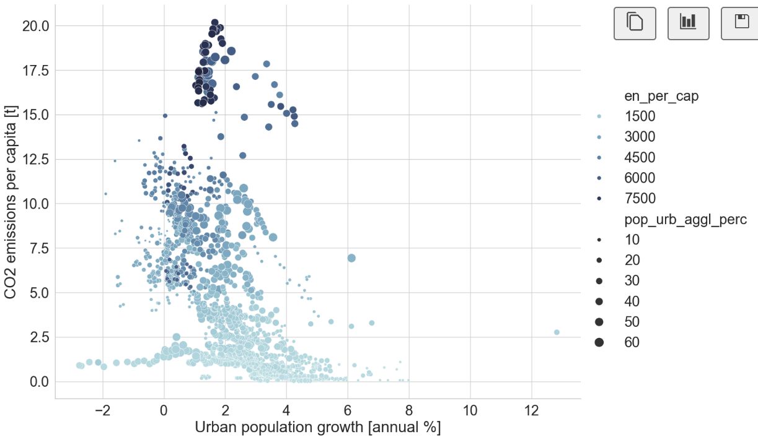
Impact of Urban Growth and Energy Use on CO₂ Emissions
Model Setup:

Slide 11
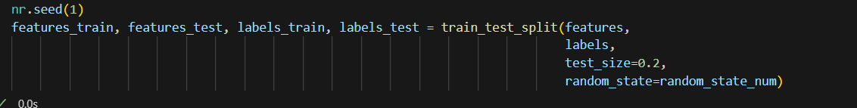
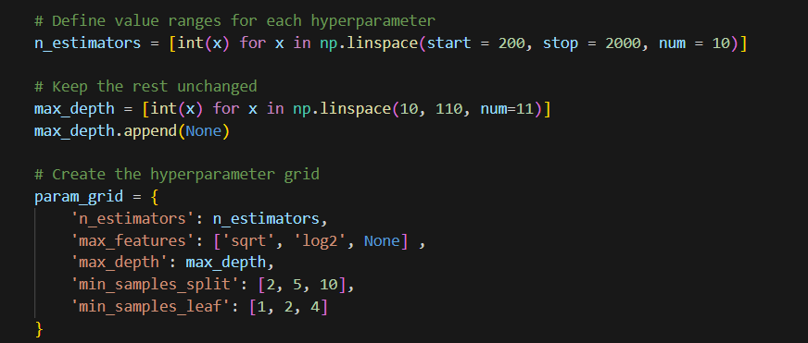
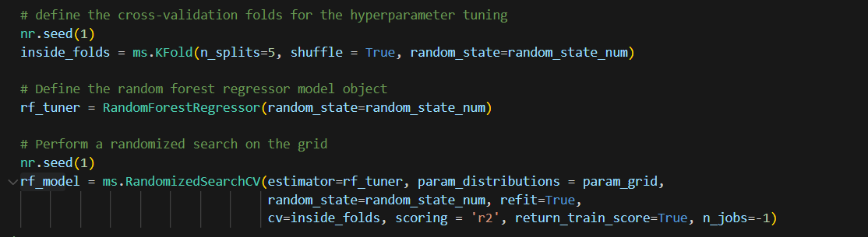
Model Training:

Slide 12
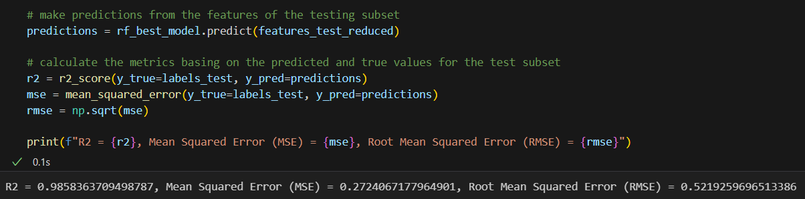
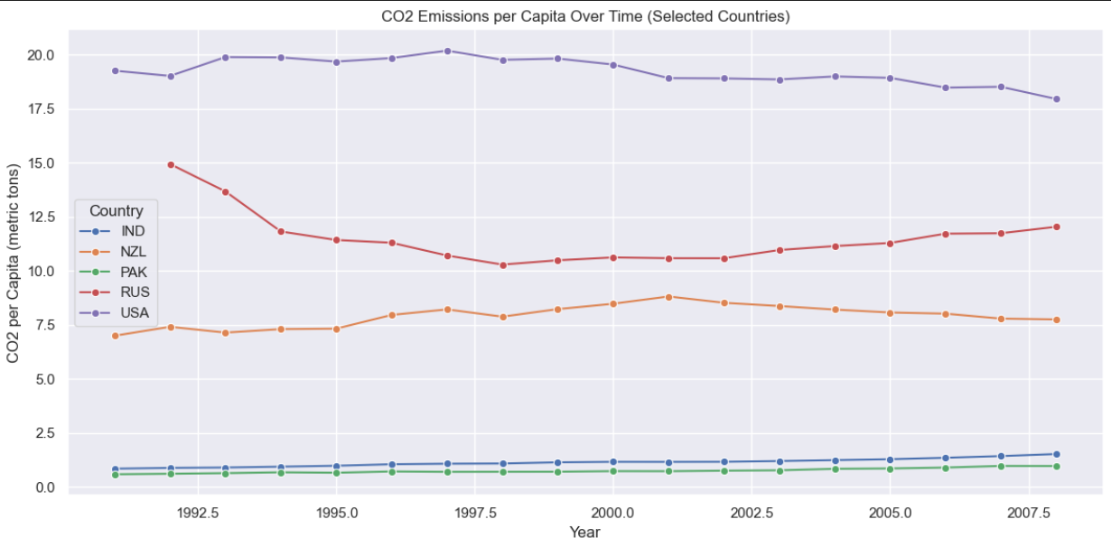
Model Training Evaluation:
Prediction:
CO₂ Emissions per Capita Over Time (Selected Countries)
Initial Graph Based on Cleaned Data (1990-2010)

Slide 13
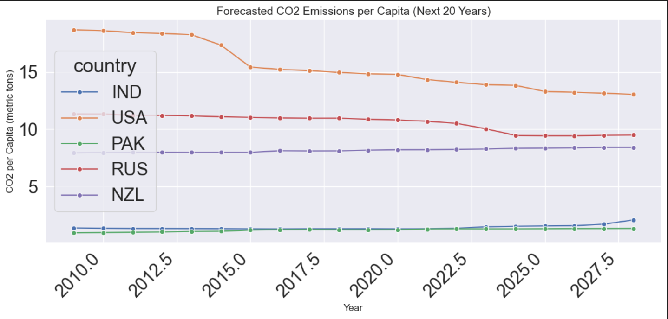
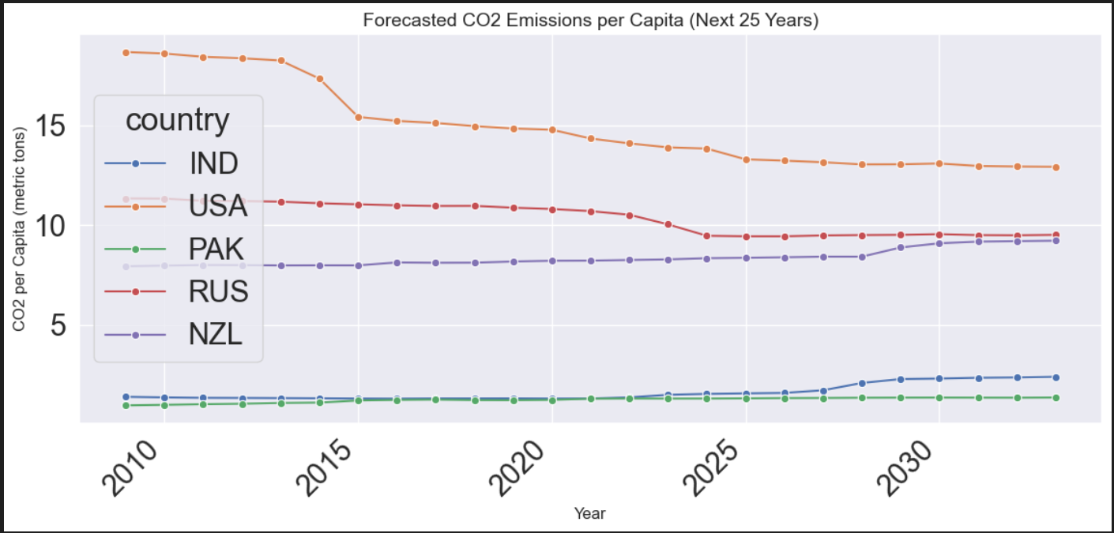
USA consistently reports the highest per capita CO₂ emissions, staying around 19–20 metric tons, with a slight downward trend in recent years.
Russia (RUS) experiences a sharp drop in the early 1990s, likely due to economic restructuring, and then levels off at about 11–12 metric tons.
Prediction of CO2 level for the next 20 Years
New Zealand (NZL) remains in the mid-range, peaking near 9 metric tons before showing a slow and steady decline.
India (IND) and Pakistan (PAK) have the lowest per capita emissions, but both display a gradual upward trend, reflecting increasing emissions linked to economic development.
Prediction of CO2 level for the next 25 Years

Slide 14
Conclusion:
In this project, we created a machine learning model to predict future CO₂ emissions in countries. We based our predictions on various indicators such as energy use per capita, GDP, urban population growth, and GNI. We started by gathering real-world datasets. Then, we cleaned, merged, and analyzed the data using descriptive statistics, visualizations, and pairwise plots.
For modeling, we chose Random Forest Regressor because it can handle non-linear relationships and complex feature interactions. To make the model more accurate, we fine-tuned the hyperparameters with RandomizedSearchCV and cross-validation. The model reached a high R² score of about 0.986, showing strong predictive power on new test data.
Next, we used the trained model to forecast CO₂ emissions for 20 to 25 years for selected countries. These predictions illustrate how emissions may change under current trends and highlight key differences between countries like India, the USA, and Russia.
Overall, this project shows how machine learning can serve as a useful tool for analyzing environmental data, forecasting emissions, and aiding decision-making for climate change mitigation. With more refinement and real-time data, such models could help governments and researchers develop better sustainability policies.

